Slide 1
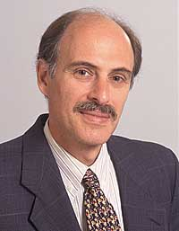
The costs and benefits of ownership: A theory of vertical and lateral integration
Grossman and Hart (1986)
Journal of Political Economy

Slide 2
A Brief Review of TCE
Coase (1937): transactions will be organized in the firm when the cost of using the firm is lower than the cost of using the market.
Klein, Crawford, and Alchian (1978), as well as Williamson (1979) maintain that a contractual relationship will likely be plagued by opportunistic (and inefficient) behavior when there are large amounts of surplus to be divided ex post and in which the ex-ante contract does not specify a clear division of this surplus.

Slide 3
A Brief Review of TCE
Two questions regarding integration are still unsolved:
The benefits and costs of integration: How can integration ever be worse than non-integration- that is, what limits the size of the firm?
The definition of integration: What does it mean for one firm to be more integrated than another?

Slide 4
Key Ideas
Ownership and integration decisions involve a trade-off between costs and benefits
Ownership Structure Optimization:
The best ownership setup aims to minimize losses from investment distortions.
Various ownership arrangements can lead to different investment levels, causing either too much or too little investment.
Integration offers advantages like enhanced coordination and efficiency.

Slide 5
Introduction
The firm is composed of the assets (e.g., machines, inventories) that it owns or over which it has control.
Contractual rights: specific rights and residual rights
Ownership is the purchase of these residual rights of control.
This article shows that there can be harmful effects associated with an inappropriate allocation of residual rights.
Develop a theory of integration based on the attempt of parties in writing a contract to allocate efficiently the residual rights of control between themselves.

Slide 6
The definition of Integration (Ownership)
The issue of ownership can be separated from the issue of contractual compensation. (It does not change the cost of writing down a particular contractual provision.)
What it does change is who has control over those provisions not included in the contract.
In this way, the owner of an asset has the residual rights of control of that asset, that is, the right to control all aspects of the asset that have not been explicitly given away by contract.

Slide 7
concept of ownership as the residual control ri The concept of ownership as the residual control rights
Residual Control Rights
Importance of Residual Control:
1. Imbalances in residual control rights allocation and parties' incentives can result in investment distortions.
2. Shared ownership may have adverse impacts if it distorts managers' incentives by removing their residual control rights.
Integration and Ownership

Slide 8
Key Takeaways from the Formal Model
If total and marginal benefits of investment move together, firm i ownership of firms i and j will lead to over-investment by firm i and under-investment by firm j. However, non-integration will lead to moderate investment levels by each firm. The optimal ownership structure will be chosen to minimize the overall loss in surplus due to investment distortions.
Proposition 1: If the non-contractibles q_{l} (l=1 or 2) have a small effect on firm j’s benefit Bj, it is efficient for firm i to control them.

Slide 9
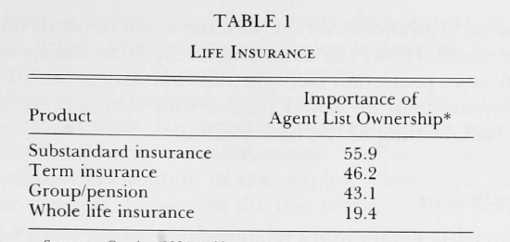
An Application in Insurance Industry
?
The list of clients
Sales Agent
Company
Two types of non-contractibles
Non-contractibles that can hurt the agent if the company owns the list → distort agent’s ex-ante effort to deliver persistent clients
Non-contractibles that can hurt the company if the agent owns the list. → distort company’s ex-ante investments in list building
Predictions: In products in which the renewal is not guaranteed and is sensitive to the agent's actions, the agent will be more likely to own the list, whereas in products in which the renewal is more certain and is less sensitive to the agent's actions, the company will be more likely to own the list.

Slide 10
Conclusions
The comparison relevant to integration is not between the non-integrated outcome and the complete contract outcome but instead between a contract that allocates residual rights to one party and a contract that allocates them to another.
When residual rights are purchased by one party, they are lost by a second party—and this inevitably creates distortions.
Integration shifts the incentives for opportunistic and distortionary behavior, but it does not remove these incentives. Thus, the optimal ownership structure will be chosen to minimize the overall loss in surplus due to investment distortions.
Connecting with the Coase Theorem (1960): The impossibility of ex ante bargaining over all aspects of the product to be delivered, that is the incompleteness of the contract, is the source of our conclusion that the distribution of property rights has efficiency consequences.

